Slide 1
Homework 1 (Due: 3/4)
繳交組員名單

Slide 2
Homework 2 (Due: 3/11)
Input a color image C(R,G,B)
Output the color image C
3. Transform the color image C into a
grayscale image I by I = (R+G+B)/3
4. Show the grayscale image I.

Slide 3
Homework 3 (Due: 3/18)
每組繳交一份報告用PPT檔

Slide 4

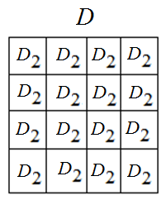
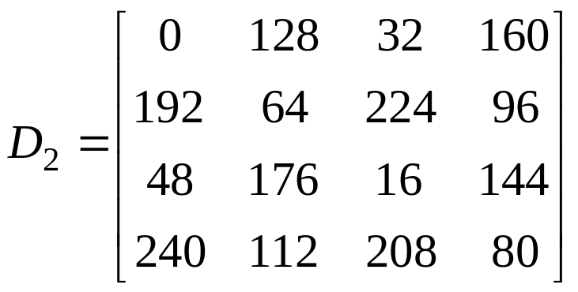
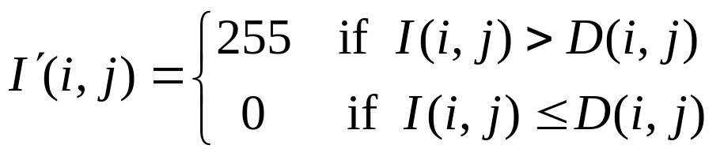

Homework 4 (Due: 3/25)
(A) Given a grayscale image I,
Step 1: Use the dithering matrix to generate an
array D of image size by repeating
Step 2: Threshold image I by
Step 3: Show images I and
3-<number>

Slide 5

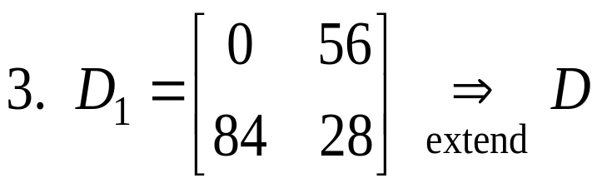
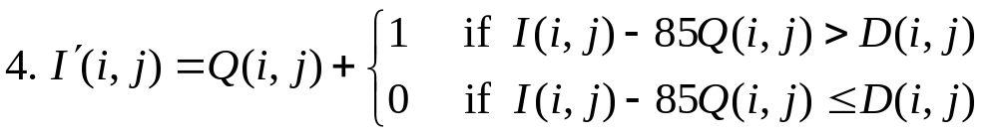

(B) Extend to n = 4 gray values
1. 255 / 3 = 85
5. Scale values of so that its values are in
[0, 255] for displaying
3-<number>

Slide 6
Homework 5 (Due: 4/8)
Develop a histogram equalization (HE) program;
Apply the HE to i) gray, ii) color images;
3. For each input image, print out the input/output images and their histograms.
4. Discuss your experiments.
For a color image C,
(i) Convert it into a gray image G;
(ii) Apply HE to G to get G’;
(iii) For each pixel of C, modify its color (r,g,b)
by (r’,g’,b’) = (r,g,b) X G’ / G.

Slide 7
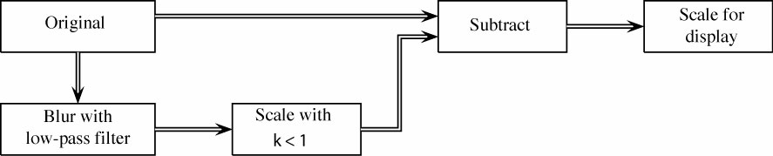
Homework 6 (Due: 4/15)
1. Select an experimental image
2. Apply a 3 by 3 (a) average filter and (b) median
filter to the image
3. Unsharp masking

